Slide 1



X
Telco Customer Churn Tendency
Revou x Kampus Merdeka Data Analytics Mentor Application
by Rayhan Narawangsa
January 2024

Slide 2
Background and Objective
Background and Objective
Background: Our telecom company have annual churn rate of 10-25%. This become a huge problem since acquiring new customers is 5-10 more pricey that retaining an existing one.
Objective: Determine root cause that make customer churn, and provide recommendations for customer portofolio retention.
Scope of Work
Driver
Approver
Responsible
Consulted
Informed
Project Initiatives by Strategy Team (Done)
Resource Approval by Head of Consumer Business (Done)
Root Cause and Action Plan
Determination by Analytics Team (On Progress)
Customer Pitching and Strategic Execution by Data Analytics and Campaign Team
Final Approval and Legal Checking by Campaign and Business Team
Analytics Approach
1
Determine Objective and Scope of Work.
3
Root Cause Determination.
Product Usage, Revenue – Cost Structure, Usage Behavior.
Univariate – Multivariate Analysis, Hyphotesis test, Generate issue tree and customer sizing
2
Data Cleansing and Exploratory Enalysis.
4
Generating Recommendations and Action Plan.
Defining target variable (Churn Tagging), Handling missing value, data engineering.
Making structured action plan to retain churning customers, Coordinate with related stekholders.

Slide 3
Dataset Understanding
Acronyms | Descriptions
MOBILE_NUMBER | Customer phone number
CIRCLE_ID | Telecom circle area to which the customer belongs to
LOC | Local calls - within same telecom circle
STD | STD calls - outside the calling circle
IC | Incoming calls
OG | Outgoing calls
T2T | Operator T to T, i.e. within same operator (mobile to mobile)
T2M | Operator T to other operator mobile
T2O | Operator T to other operator fixed line
T2F | Operator T to fixed lines of T
T2C | Operator T to it’s own call center
ARPU | Average revenue per user
MOU | Minutes of usage - voice calls
AON | Age on network
PCK | Prepaid service schemes called - PACKS
NIGHT | Scheme to use during specific night hours only
MONTHLY | Service schemes with validity equivalent to a month
SACHET | Service schemes with validity smaller than a month
FB_USER | Service scheme to avail services of Facebook or similar sites
VBC | Volume based cost
ONNET | All kind of calls within the same operator network
OFFNET | All kind of calls outside the operator T network
ROAM | Indicates that customer is in roaming zone during the call
Acronyms | Descriptions
SPL | Special calls
ISD | ISD calls
RECH | Recharge
NUM | Number
AMT | Amount in local currency
MAX | Maximum
DATA | Mobile internet
3G | 3G network
AV | Average
VOL | Mobile internet usage volume (in MB)
2G | 2G network
*.6 | KPI for the month of June
*.7 | KPI for the month of July
*.8 | KPI for the month of August
*.9 | KPI for the month of September
1
2
2
3
Analysis will be on mobile_number level as primary key. Each are complimented by demography data in Age of Network and Circle_ID (Area Code).
Types of product offered from T Network are General Calls and Internet packs. The data includes usage detail sush as usage volume, channel, and packs offered.
The data provided includes financial aspect as in Average Revenue and Volume Based Cost per mobile_number.
3

Slide 4
Data Cleansing – Missing Value Findings
Massive portion of rows with missing value are found in several key features.
Most features with highest percentage is related to recharge data, revenue, and packs.
General approaches of handling missing value are applied to anticipate this case.
Columns | Missing Value (%) | Columns | Missing Value (%)
date_of_last_rech_data | 75% | av_rech_amt_data | 74%
total_rech_data | 75% | arpu | 74%
max_rech_data | 75% | night_pck_user | 74%
count_rech | 75% | fb_user | 74%
Cases of Handling Missing Value
In facing massive amount of data, we need efficient approach to handle missing values. Used Approach: Data Reduction and Replacement using Statistic Imputation.
Data Reduction
Illustration
Drop columns: Used for targeted columns with huge portion of missing value (used threshold > 40%), and are less relevant to the analysis.
Targeted Columns: Last_date_of_month.
Mobile Number | Last_date_ of_month | Circle_id | fb_user_6 | fb_user_7 | total_ic_6 | total_ic_7 | std_ic_ mou
708+++++ | 31/06 | 1248 | 1 | 1 | 87.1 | 34.9 | NaN
701+++++ | NaN | 1273 | 0 | NaN | 280.08 | 216.61 | 4.94
702+++++ | 31/06 | NaN | 0 | 0 | 532.8 | NaN | 458.5
Action | Drop Column |  | Replace with 0 |  | Replace with Median
Statistics Imputation
Replace with number 0: Targeted column have clear rules with high confidence level in changing data distribution (eg. fb_user).
Replace with Median: to effectively replace missing values in huge number of columns (eg std_ic_moud, etc).

Slide 5
Exploratory Analysis – Defining Churn Variables and Generate Additional Feature
Churn Variables
Customers (mobile_number) who have shown no activity, including both incoming and outgoing calls, as well as internet usage, during the month of September (month 9). Churn Value: 1 for customer churn, 0 for customer non churn.
Illustration
Customer Sizing
Target Period
Target Period
Mobile Number | Inet Usage Month 6 | Inet Usage Month 7 | Inet Usage Month 8 | Inet Usage Month 9 | Calls Usage Month 6 | Calls Usage Month 7 | Calls Usage Month 8 | Calls Usage Month 9 | Churn
708+++++ | 54 | 39 | 12 | 0 | 543 | 492 | 532 | 548 | 0
701+++++ | 32 | 25 | 41 | 38 | 679 | 432 | 125 | 0 | 0
703+++++ | 21 | 17 | 6 | 0 | 320 | 179 | 53 | 0 | 1
Status | # Customer | % Customer
Churn | 10,191 | 10.2
Non Churn | 89,808 | 89.8
Total | 99,999 | 100
Additional Feature
Customer Journey
Additional Feature
Product Purchase
Customer Behavior
Churn or Non Churn
What data or feature will be best to define customer behavior pattern and changes?
Behaviour Sum first 3 month
Behaviour Trend first 3 month
Behaviour Average first 3 month
Years Age of Network

Slide 6
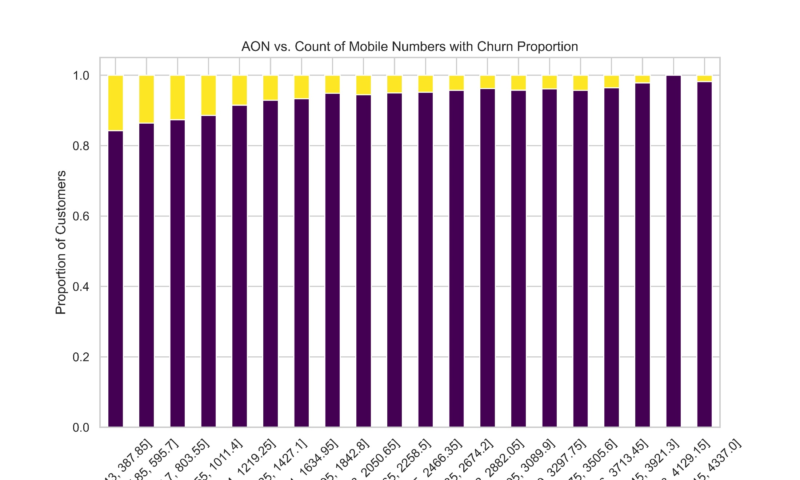
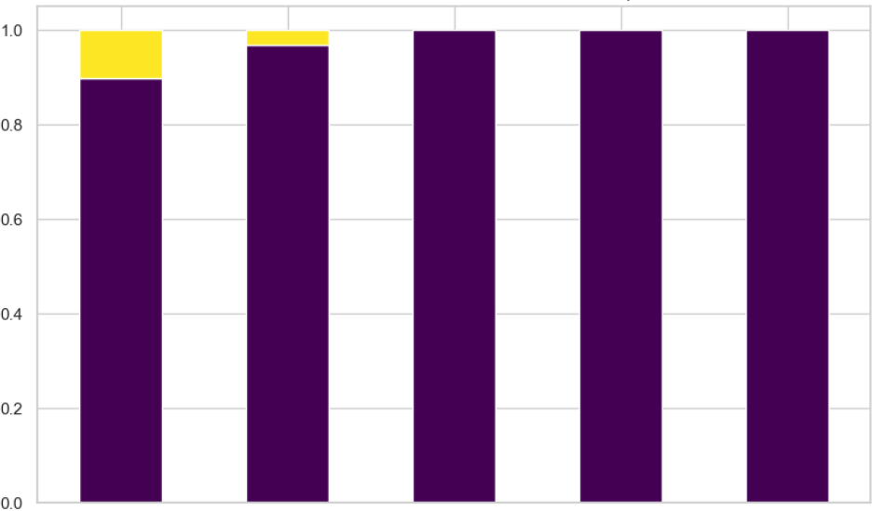
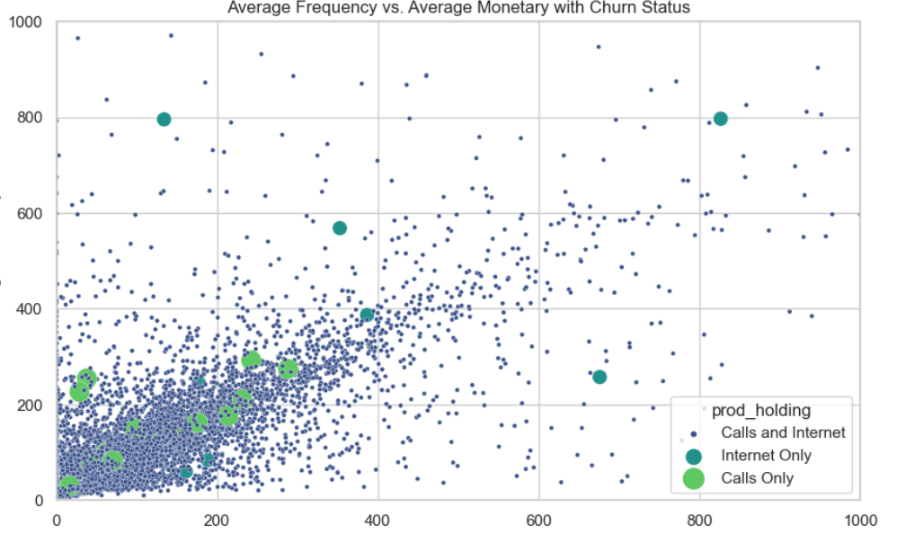
Exploratory Analysis and Hipothesis Determination
Churn Sizing vs Age of Network (AON)
Churn Sizing vs Usage Frequency
1
2
Percent Churn Customer
Percent Churn Customer
388
1,427
2,466
3,506
4,337
1,723
3,446
5,169
6,892
8,615
Age of Network
Total Usage Frequency
Churn Sizing vs Monetary vs Products Usage
3
Non Churn Customers
Churn Customers
* Average Revenue = Total Revenue Calls and Internet
** Total Usage Frequency = Total Usage Calls and Internet After Normalized
Average Revenue
Hyphotesis
Customers with low Age of Network are more likely to churn.
Customers with low product utilization are more likely to churn.
Retaining customers who hold product Internet only is more profitable than Calls only.
Total Usage Frequency

Slide 7
Churn Customer RFM Clustering
Variables (First 3 Month Behavior) |  | Cluster A (Champion) | Cluster B (Dynamic Achievers) | Cluster C (Balanced Explorers) | Cluster D (Efficient Subscriber) | Cluster E (Fresh Minimalist)
Customer Sizing |  | 20,000 cust. | 20,000 cust. | 19,999 cust. | 20,000 cust. | 20,000 cust.
Churn Customer Sizing |  | 525 cust. (2.6%) | 1,093 cust. (5.5%) | 1,566 cust. (7.8%) | 2,122 cust. (10.6%) | 4,885 cust. (24.4%)
Age of Network |  | 58 months | 41 months | 40 months | 42 months | 23 months
Recency | Gap from last Call Recharge | 4 days | 5 days | 6 days | 9 days | 16 days
 | Gap from last Inet Recharge | 12 days | 34 days | 49 days | 57 days | 60 days
Frequency* | Outgoing Calls Minutes | 500 minutes | 403 minutes | 313 minutes | 193 minutes | 121 minutes
 | Incoming Calls Minutes | 324 minutes | 230 mintues | 192 minutes | 157 minutes | 97 minutes
 | 2G Internet Volume Usage | 148 mb | 77 mb | 25 mb | 4 mb | 0.5 mb
 | 3G Internet Volume Usage | 461 mb | 147 mb | 29 mb | 4 mb | 0.8 mb
Monetary* | Revenue per Person from Calls | 508 cu | 349 cu | 256 cu | 188 cu | 117 cu
 | Revenue per Person from Inet | 83 cu | 23 cu | 5 cu | 5 cu | 0.2 cu
Revenue x Churn Customer** |  | 310,275 cu | 406,496 cu | 408,726 cu | 409,546 cu | 572,522 cu
1
2
3
4
* Average first 3 month
** Total Revenue (Calls and Internet) times by Number of Churn Customer
Key Highlight
Based on churn percentage, Fresh Minimalist customers are more likely to churn.
Churn customers typically exhibit a more longer gap from their last recharge cycle to the current month (September).
Customer with low product usage is more likely to churn. Better product usage to determine churn tendency is internet.
Highest revenue lost are from cluster Fresh Minimalist.

Slide 8
Customer Churn Trigger – Issue Tree
Cluster A (Champions)
Consistent Query,Usage Decreasing >60%*
70% customer with Usage Decreasing
User Experience Issues
Sizing: 10%**
Products Dissatisfaction
Inconsistent Query,Usage Decreasing >60%*
Interest in Competitor Product
Sizing: 90%**
Cluster A and E is chosen to determine root cause for its representative natures.
Why Customers Churn?
Age of Network >= 2 years*
Avg. Calls 167 minutes, Avg. Inet Vol. 0.1 mb
Lack of Product or Campaign Exposure
Sizing: 27%**
Low Product Utilization
Age of Network < 2 years*
Customer Secondary Service
Sizing: 73%**
Cluster E (Fresh Minimalist)
Definition
Key Highlights
* Used threshold for customer sizing. Population is from Churning customer in each respective Cluster.
** Used to determine the main cause of churning between two primary types of Customer cluster (Champions and Fresh Minimalist).
The two main cause of customer churning are Interest in Competitor Product and Non Focus Awareness from Customer

Slide 9
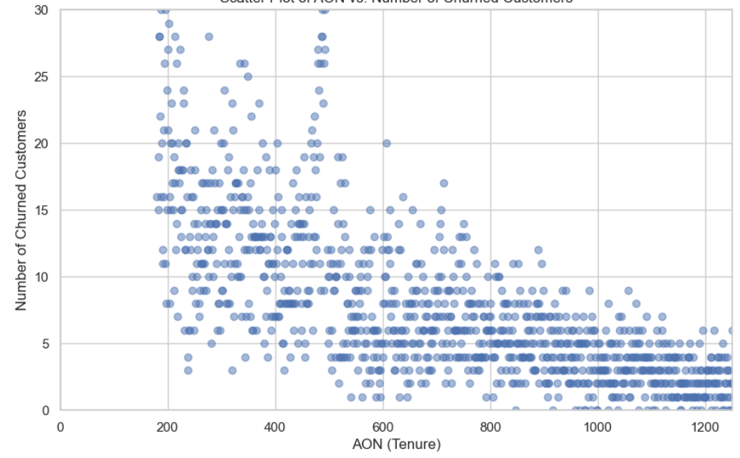
Strategy and Action Plan – Hyphothesis Test
Example Correlation Plot AON vs Churn Customers
Approach
Customer distribution plot provide support on finding relationship between features
In AoN vc Churn Customer case, plot suggest there is high correlation between age of network and number of churned customers.
Logistic Regression is used to find the statistics prove to support hyphothesis.
P-value shows from the relationship between Age of Network and Number of Churn Customer is <0.05, which surpass limit of 95% confidence level.
Currelation plot and Logistic Regression is also generated for other hyphotheiss, which also shows similar result, suggesting that all 3 hyphothesis is correct:
Hyphothesis |  | Function Value | Logistic Regression Coefficient | P-Value | Status
Customers with low Age of Network are more likely to churn. |  | 0.319784 | -0.06263 | 0.011862 | Correct
Customers with low product utilization are more likely to churn. |  | 0.318215 | -0.46827 | 0.023827 | Correct
Retaining customers who hold product Internet only is more profitable than Calls only. | Internet Usage vs Churn Sizing | 0.331627 | -0.34162 | 0.024612 | Correct
 | Calls Usage vs Churn Sizing | 0.332562 | -0.34923 | 0.031592

Slide 10
Strategy and Action Plan
Variables (First 3 Month Behavior) |  | Cluster A (Champion) | Cluster E (Fresh Minimalist)
Customer Sizing |  | 20,000 cust. | 20,000 cust.
Churn Customer Sizing |  | 525 cust. (2.6%) | 4,885 cust. (24.4%)
Age of Network |  | 58 months | 23 months
Recency | Gap from last Call Recharge | 4 days | 16 days
 | Gap from last Inet Recharge | 12 days | 60 days
Frequency* | Outgoing Calls Minutes | 500 minutes | 121 minutes
 | Incoming Calls Minutes | 324 minutes | 97 minutes
 | 2G Internet Volume Usage | 148 mb | 0.5 mb
 | 3G Internet Volume Usage | 461 mb | 0.8 mb
Monetary* | Revenue per Person from Calls | 508 cu | 117 cu
 | Revenue per Person from Inet | 83 cu | 0.2 cu
Revenue x Churn Customer** |  | 310,275 cu | 572,522 cu
1. Build promotion campaign to retain churning customers with higher product usage.
2. Build promotion campaign to transform new customers with low usage, into high usage customer.
3
3. Put more focus on churning customer with internet only product holding, with relatively higher monetary values.
1
2
Next Action Plan
Build machine learning model to predict Champions customer that will churn
Root Cause and Action Plan Determination by Data Analytics Team (Done)
Customer Pitching and Strategic Execution by Data Analytics and Campaign Team (Next)
Final Approval and Legal Checking by Campaign and Business Team

Slide 11
X
Thank you
Revou x Kampus Merdeka Data Analytics Mentor Application
by Rayhan Narawangsa
January 2024

